Slide 1

Conservation Assessment Ranking Tool Soils
May 2, 2019

Slide 2
CART Overview

Slide 3

CART Development
Conservation Train
PI 1
Nov 2018
PI 2
Jan 2019
PI 3
April 2019
PI 4
June 2019
PI 5
Aug 2019
10/01/18
09/30/19
* Program Increment (PI)
Notes:
Every 10 weeks the Business (NRCS) and the Developers (ASRC) meet in Ft Collins for a PI Planning Meeting for mission and vision planning and to develop objectives and feature for the upcoming PI. Additionally the workload is assigned to a specific 2-week iteration in the form of user stories to be developed. During each two week iteration the developers share their progress with the business (NRCS) and priorities are evaluated with necessary changes incorporated.

Slide 4
CART Field Office Workflow
Enhanced Field Office Workflow
Planner Pre-Screens as determined by State
Planner Creates Schedule
Pick PLUs
Planner Creates Assessment
Select RC
Assess Existing Condition including Existing Practices
Select New Practice
Planner Override
Collect Special Concerns Info
Complete Assessment
Planner Ranks Assessment Practices
Identify applicable Ranking Pools
Score Priority Questions
Finalize Score
Estimate Cost by Ranking Pool
Program Manager Selects Assessment and associated Practices by Ranking
Planner Completes Plan
Digitizes Practices
Contract Wizard
Planner Finalizes
Contract
Client Info and/or Field Visits conducted as appropriate
May Start Application, including eligibility, but must be completed by end of Ranking Process
Workflow Application
Protracts
CD
CART
CPDES
FM
Notes:
CART workflow follows the 9-step planning process and continues to support in-field focused and customer specific resource inventory and assessment.

Slide 5
CART Configuration Workflow
Configuration Prior to Field Office Workflow
Resource Concern, Practices, and Points
Assessment Question Configuration
Geospatial
Questions
Spending Plan and line items
Program Manager Configuration of Ranking Pools
Geospatial
Questions
National development
of questions and answers
National and state development of questions and answers
Workflow Application
Protracts
CD
CART
CPDES
FM
Notes:
Configuration of CART will be done by national and state stewards.
Assessment configuration - completed by national data stewards.
Ranking configuration – completed by national and state data steward.

Slide 6
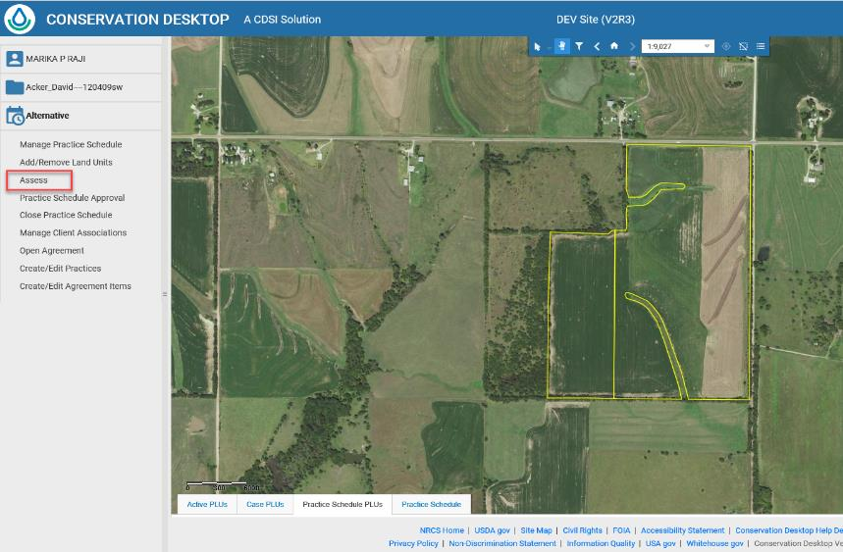
Conservation Desktop
Notes:
CART Assessment starts with a Conservation Desktop Practice Schedule.
Existing PLUs and existing practices are used in the assessment process.
New practices can be added in CART.

Slide 7
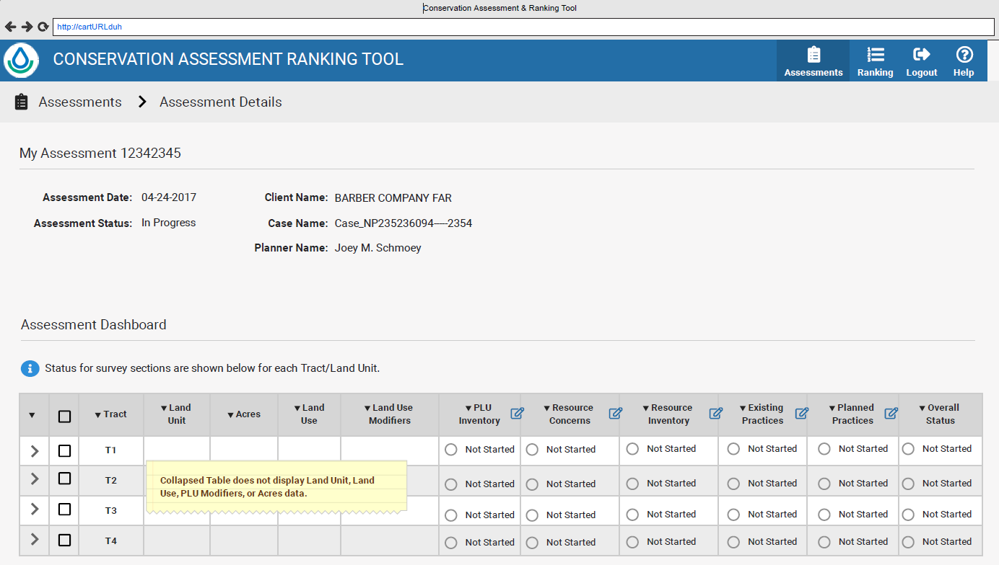
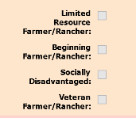
CART Assessment
Notes:
Here we can seed the Tracts and land units that originated in CD. The assessment Tracts listed in the lower left can be expanded to see individual land units for a more detailed view and for flexibility to assess the land units individually or as a group of land units within or between Tracts.
Text and geospatial questions are grouped in surveys as seen to the right of the Tracts and Land Units. Surveys of questions can be opened and answered with the status changing from Not Started to In Progress to Completed as the planner completes the assessment.

Slide 8
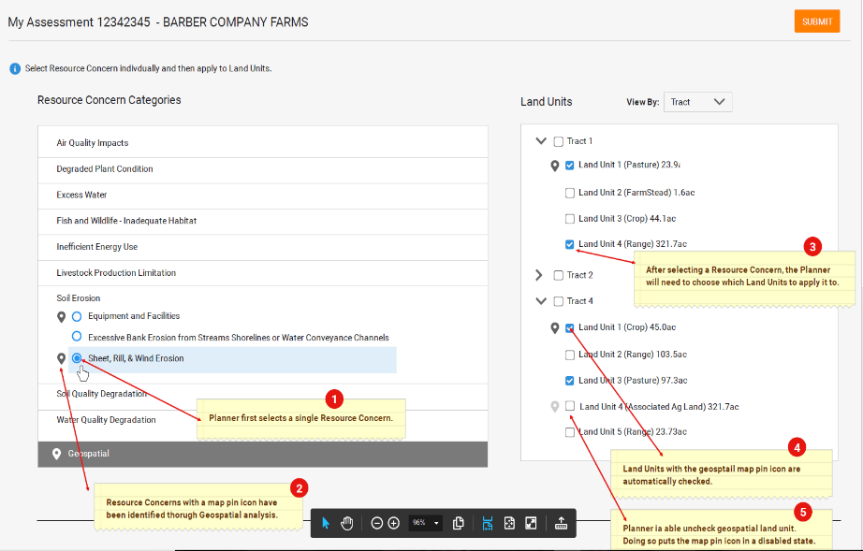
CART Assessment – Resource Concerns
Notes:
Determine Objectives.
CART provides planning criteria to address the resource concerns and information about ecological site protection. Planner will identify Clients objectives for resource concerns which are evaluated and measured.

Slide 9
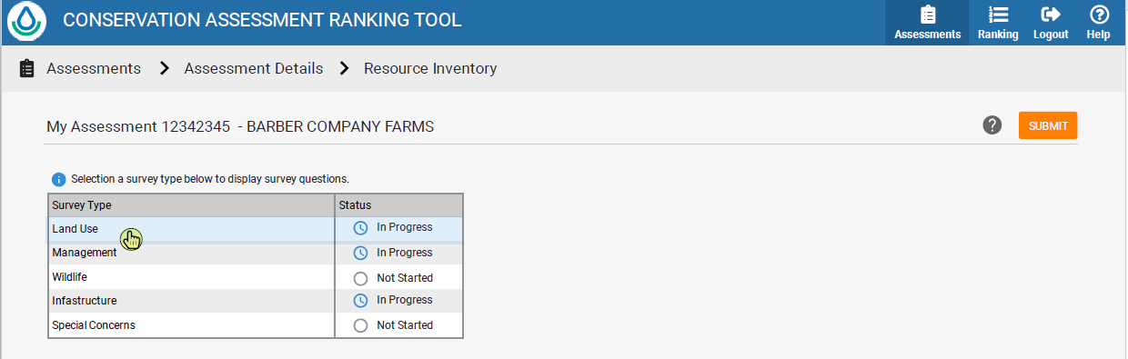
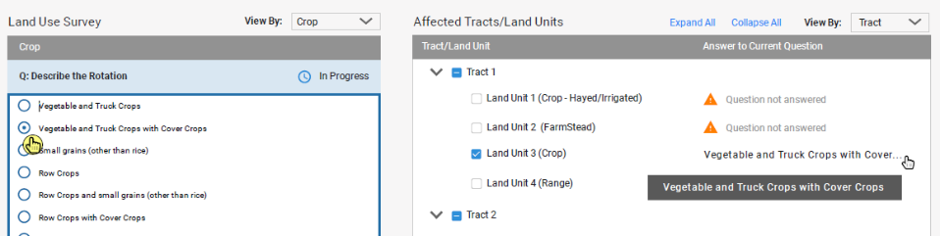
CART Assessment – Existing Conditions
Notes:
3. Inventory Resources
CART uses a resource inventory which incorporates geospatial data, existing practices, field visit, and client input.

Slide 10
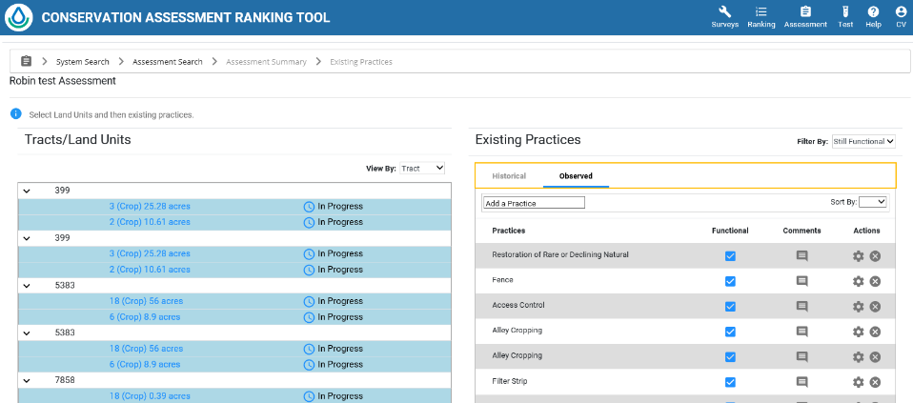
CART Assessment – Existing Practices
* Practices can be turned off if no longer functioning
Notes:
3. Inventory Resources
Historical practices in NPAD
Observed practices not in NPAD but the planner identifies when doing field visits.
The planner will also be able to add planned practices to address identified resource concerns.
The planned practices in CART will not be digitized initially, only added to calculate additional benefit to addressing the identified resource concern.
Once the plan is back in CD, the planner will digitize the location of the new practices identified in CART.

Slide 11
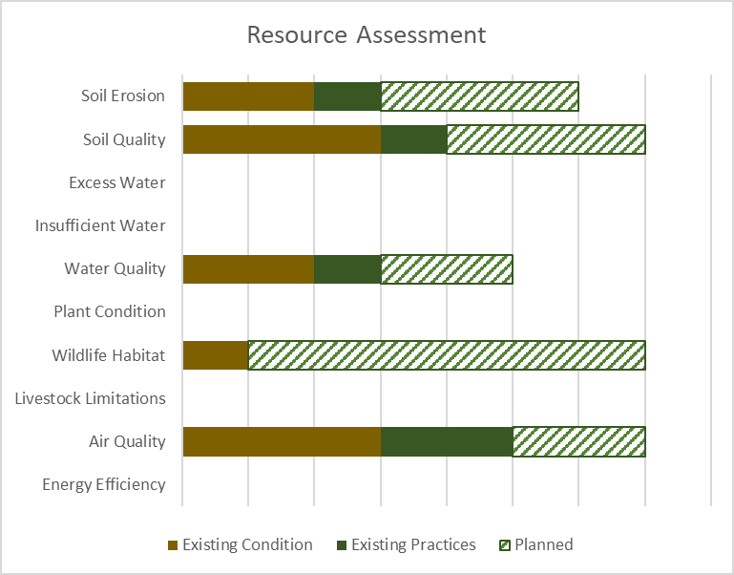
CART Assessment
Threshold
Existing Conditions
Existing Practices
Planned Practices
Notes:
This is a graphic representation similar to a report that CART will generate. I use it in this context to explain how test and geospatial questions and answers are used to assess the practice schedule as a whole and in more detail to the PLU.
CART assists planners illustrate various alternative practices and their effect on the resource concern. Additionally, CART will identify funding sources to offset the expense of conservation practices
CART will allow
Comparison of effects from different conservation practices
Multiple program ranking pools assessments for funding
Collection, recording, and evaluation of environmental assessment information currently captured on the CPA-52.

Slide 12
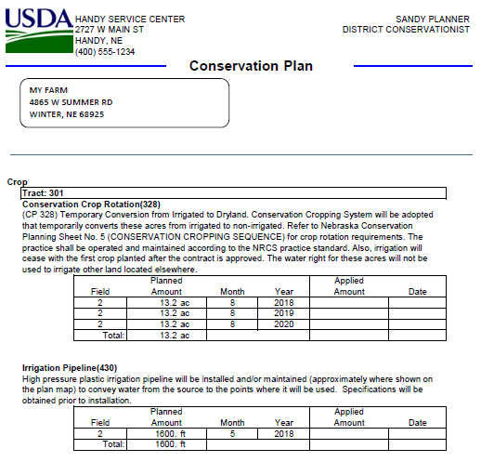
CD – Record of Decision
Notes:
CART will integrate with Conservation Desktop (CD) to turn the client’s selected alternative into a written conservation plan.
CART will also support Farm Bill program ranking for funding decisions. When the client choose to use a program, CART completes ranking using the already collected resource inventory and geospatial information to the greatest extent possible.

Slide 13
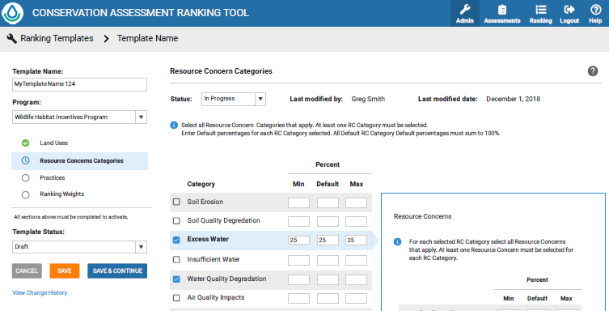
CART - Ranking
Notes:
Screenshot of what the Program Ranking Steward will develop.
Not what the planner sees.

Slide 14
USDA Geospatial Services
Soil Data Access
CART specific services developed by NRCS NSSC
Conservation Resource
Geospatial assets using NRCS soils data for use within CART and the Resource Stewardship Evaluation Tool (RSET)
Geodata
NGCE curated national datasets
CART Resource Data Team providing work request for national data to NGCE
GeoPortal
Published and maintained by State Geospatial Data Steward

Slide 15
How is Geospatial Data Used in CART

Slide 16
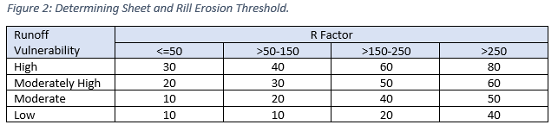
Threshold
Measure of Intrinsic Site Vulnerability and amount of conservation effort to reach a “sustainable” level
From NB 440-19-9, Attachment A – CART Resource Concern Assessment
Soil Erosion – Sheet and Rill

Slide 17
Soil Quality Degradation
CART has four resource concerns related to Soil Quality Degradation and each will involve analysis of soil interpretation data from the Soil Data Access Query service. Soil maps and reports for these interpretations are also available from Web Soil Survey. Both applications are connecting to the same soils database.
 | Resource Concern | Soil Interpretation
1 | Subsidence | Agricultural Organic Soil Subsidence
2 | Compaction | Soil Susceptibility to Compaction
3 | Organic Matter Depletion | Organic Matter Depletion
4 | Concentration of Salts and Other Chemicals | Surface Salt Concentration

Slide 18
Soil Data Access Requests by CART
The request for soils data begins once landunits have been selected.
The request is in the form of an SQL query and contains:
Landunit identifier
Bounding coordinates
CART will automatically send the request to Soil Data Access Query Service.
Map layers are processed in the background and will not be displayed.
Park County, Wyoming (245 acres)

Slide 19
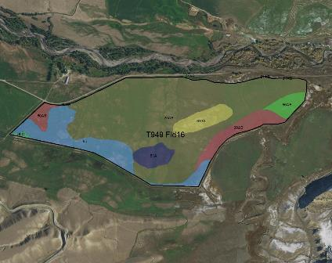
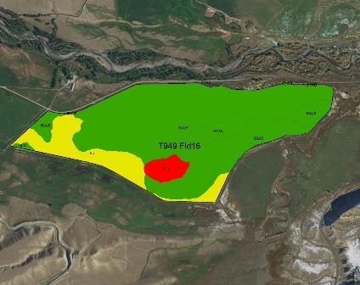
Map data is processed in the background
Basic Soil Map
Risk of Surface Salt Concentration
The map on the left shows 8 different soils within this landunit. The map on the right side illustrates risk of surface salinization. The red polygon indicates an area of high risk for surface salinization, yellow areas have a moderate risk and green areas are low risk.

Slide 20
Service Data
In the example below, the Query service has returned soils data for the ‘Risk of Surface Salt Concentration’ within the landunit. The rating data shown in table below is then used to calculate the magnitude of each rating as both a landunit percentage and as landunit acres.
Landunit | Soil Interpretation Name | Soil Interpretation Rating | Rating Number | CART Rating | Rating Percent | Rating Acres | Land Unit Acres | Rolling Percent | Rolling Acres
T949 Fld16 | Surface Salt Concentration | High surface salinization risk or already saline | 1 | Surface Salt Concentration:1 | 3.9 | 9.54 | 244.78 | 3.9 | 9.54
T949 Fld16 | Surface Salt Concentration | Surface salinization risk | 2 | Surface Salt Concentration:2 | 15.2 | 37.20 | 244.78 | 19.1 | 46.74
T949 Fld16 | Surface Salt Concentration | Low surface salinization risk | 3 | Surface Salt Concentration:3 | 80.9 | 198.04 | 244.78 | 100.0 | 244.78
Areas with the highest risk will be assigned a rating number of 1. Areas with a lower risk will be assigned a larger rating number. Rating values are calculated using soils data at the component level.

Slide 21
Landunit Detailed Ratings
The service request then calculates the rolling sum values for rating_acres and rating percent for each resource concern and finds the single most limiting rating (per landunit) that comprises at least 10% by area or 10 acres.
Landunit | Soil Interpretation Name | Soil Interpretation Rating | Rating Number | CART Rating | Rating Percent | Rating Acres | Land Unit Acres | Rolling Percent | Rolling Acres
T949 Fld16 | Surface Salt Concentration | High surface salinization risk or already saline | 1 | Surface Salt Concentration:1 | 3.9 | 9.54 | 244.78 | 3.9 | 9.54
T949 Fld16 | Surface Salt Concentration | Surface salinization risk | 2 | Surface Salt Concentration:2 | 15.2 | 37.20 | 244.78 | 19.1 | 46.74
T949 Fld16 | Surface Salt Concentration | Low surface salinization risk | 3 | Surface Salt Concentration:3 | 80.9 | 198.04 | 244.78 | 100.0 | 244.78
In this example, it is the second row that meets these criteria and will be provided to the CART application as the landunit rating for Concentration of Salts and Other Chemicals. It is important to understand that the functionality for calculating landunit ratings is not available from Web Soil Survey. It is only designed to provide soil maps and reports.

Slide 22
Final Landunit Ratings
The final Soil Data Access landunit ratings for each of the resource concerns will be returned to CART for awarding of points. The publication date of the soils data will also be returned to CART as metadata. This will ensure that any of the Soil Quality Degradation ratings can be tied back to a particular version of SSURGO soils data.
Landunit | Landunit Ratings | Soil Survey Publication Date
T949 Fld16 | Agricultural Organic Soil Subsidence:4 | WY629 2018-09-14 18:51:24
T949 Fld16 | Organic Matter Depletion:2 | WY629 2018-09-14 18:51:24
T949 Fld16 | Soil Susceptibility to Compaction:1 | WY629 2018-09-14 18:51:24
T949 Fld16 | Surface Salt Concentration:2 | WY629 2018-09-14 18:51:24

Slide 23
This domain table contains an ordered list of all possible rating values.
Line | CART Rating | Soil Interpretation Name | Soil Interpretation Rating Class | Rating Number
1 | Surface Salt Concentration:1 | Surface Salt Concentration | High surface salinization risk or already saline | 1
2 | Surface Salt Concentration:2 | Surface Salt Concentration | Surface salinization risk | 2
3 | Surface Salt Concentration:3 | Surface Salt Concentration | Low surface salinization risk | 3
4 | Surface Salt Concentration:4 | Surface Salt Concentration | Not rated | 4
5 | Soil Susceptibility to Compaction:1 | Soil Susceptibility to Compaction | High | 1
6 | Soil Susceptibility to Compaction:2 | Soil Susceptibility to Compaction | Medium | 2
7 | Soil Susceptibility to Compaction:3 | Soil Susceptibility to Compaction | Low | 3
8 | Soil Susceptibility to Compaction:4 | Soil Susceptibility to Compaction | Not rated | 4
9 | Organic Matter Depletion:1 | Organic Matter Depletion | OM depletion high | 1
10 | Organic Matter Depletion:2 | Organic Matter Depletion | OM depletion moderately high | 2
11 | Organic Matter Depletion:3 | Organic Matter Depletion | OM depletion moderate | 3
12 | Organic Matter Depletion:4 | Organic Matter Depletion | OM depletion moderately low | 4
13 | Organic Matter Depletion:5 | Organic Matter Depletion | OM depletion low | 5
14 | Organic Matter Depletion:6 | Organic Matter Depletion | Not rated | 6
15 | Agricultural Organic Soil Subsidence:1 | Agricultural Organic Soil Subsidence | Severe subsidence | 1
16 | Agricultural Organic Soil Subsidence:2 | Agricultural Organic Soil Subsidence | Moderate subsidence | 2
17 | Agricultural Organic Soil Subsidence:3 | Agricultural Organic Soil Subsidence | Low subsidence | 3
18 | Agricultural Organic Soil Subsidence:4 | Agricultural Organic Soil Subsidence | Mineral soil | 4
19 | Agricultural Organic Soil Subsidence:5 | Agricultural Organic Soil Subsidence | Not rated | 5
20 | Suitability for Aerobic Soil Organisms:1 | Suitability for Aerobic Soil Organisms | Not favorable | 1
21 | Suitability for Aerobic Soil Organisms:2 | Suitability for Aerobic Soil Organisms | Somewhat favorable | 2
22 | Suitability for Aerobic Soil Organisms:3 | Suitability for Aerobic Soil Organisms | Very favorable | 3
23 | Suitability for Aerobic Soil Organisms:4 | Suitability for Aerobic Soil Organisms | Not rated | 4

Slide 24
Future Considerations

Slide 25
Future Considerations
Explore additional NGDA and other services
Explore use of state data for assessment
Raster data and processing
Data archival
Visualization

Slide 26
Demo CART DEV

Slide 27
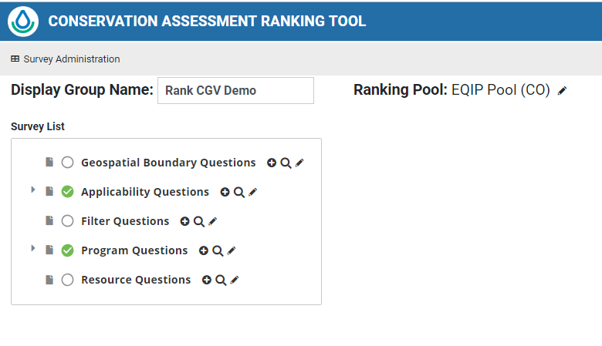
Ranking Q&A

Slide 28
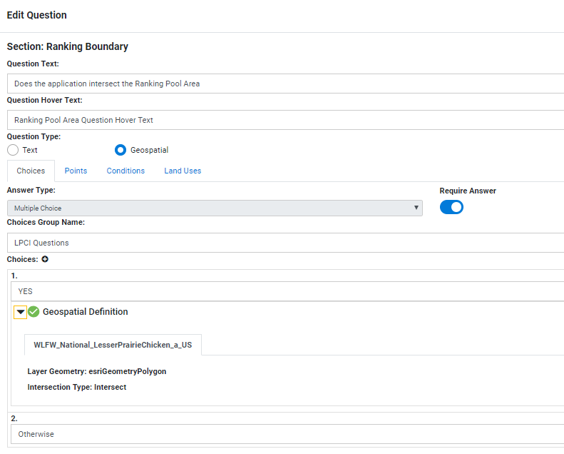
Ranking Q&A

Slide 29
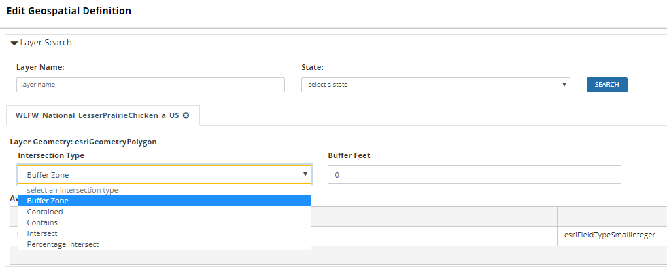
Ranking Q&A – Geoprocessing options

Slide 30
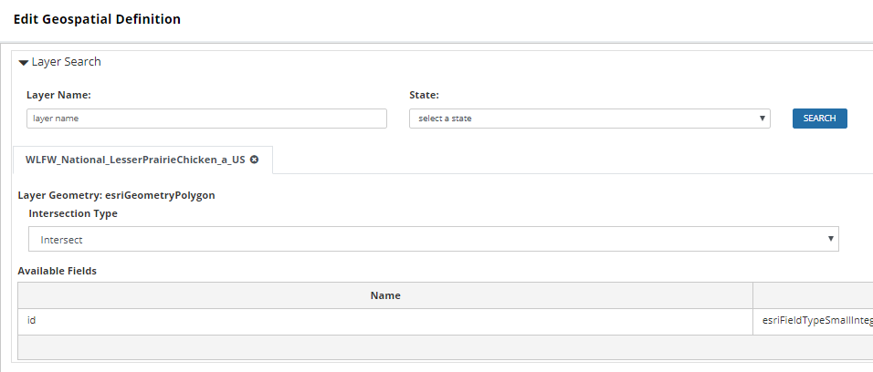
Ranking Q&A - Intersect

Slide 31
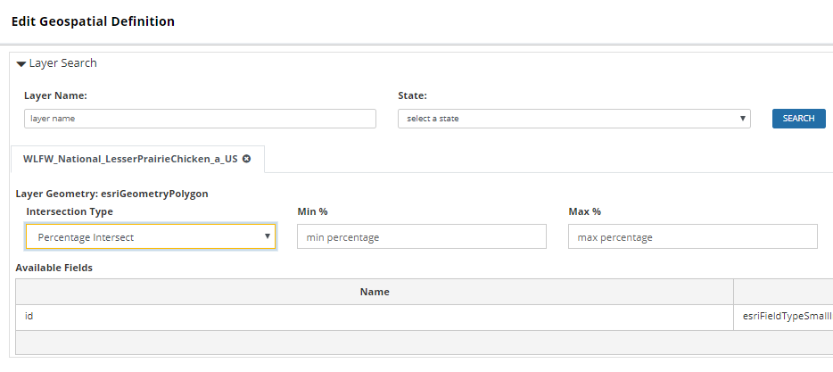
Ranking Q&A – Intersect with percent

Slide 32
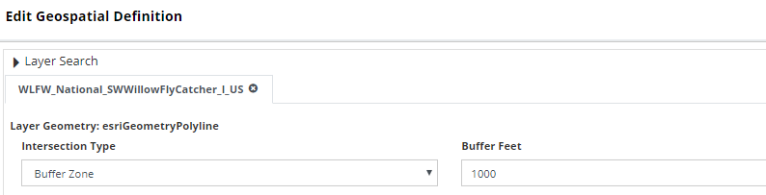
Ranking Q&A – Buffer

